Slide 1
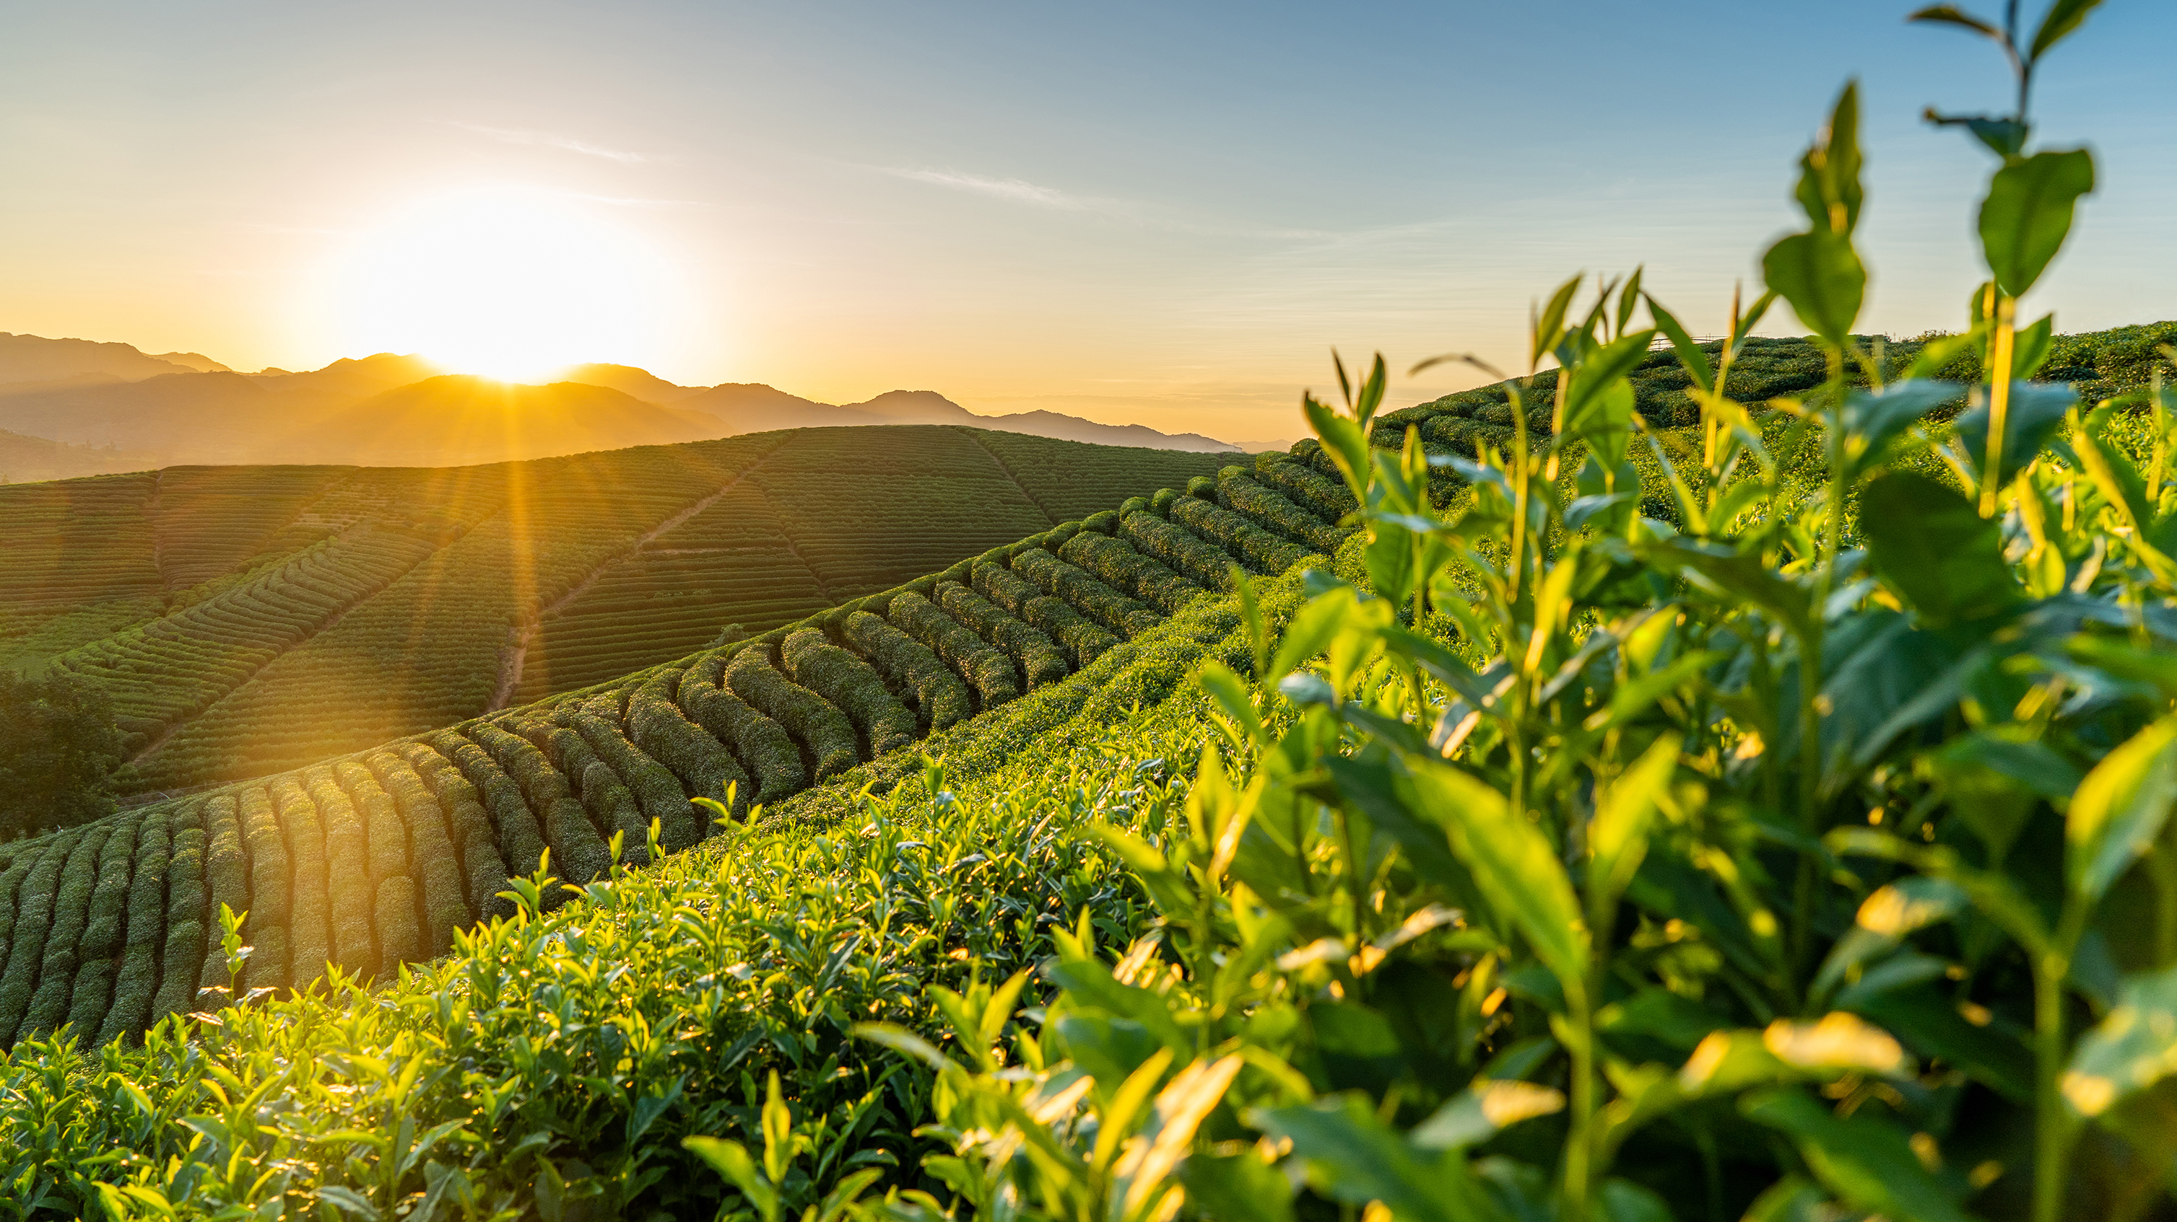
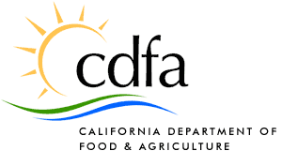
Framework for defining Regenerative Agriculture February 9, 2023

Slide 2
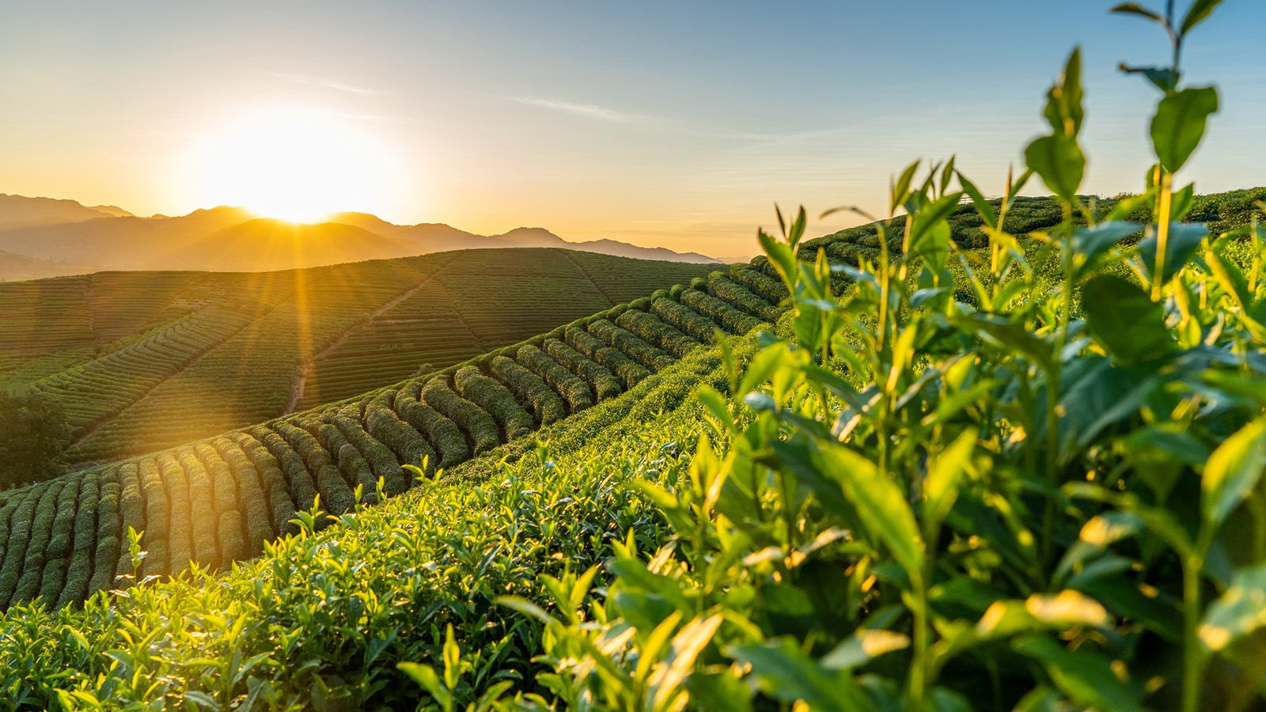
Background and purpose
October letter from State Board of Food and Agriculture
Asked for a literature review and framework definition by February 2023
December 13 Expert Panel & Science Advisory Panel discussion
Notes:
On October 17, the State Board of Food and Agriculture Sent a letter to Chair Dlott asking for assistance from the Science Advisory Panel with defining regenerative agriculture.
The letter cited the increased prevalence and use of the term in recent years, including in 2022 legislation related to the California Energy Commission’s Climate Innovation Program. While limited to that particular program, the board was concerned that the definition used doesn’t meet a science-based criterion for the designation or recognition of the term “regenerative”.
The Board asked for a literature review and framework definition, to be provided by February 2023.
Many of you probably recall that this was a major topic of discussion at the December meeting of the EFA SAP. Today I would like to review the content of that discussion, then my colleague Dana Brady-Yount, who is a scientist in the Office of Environmental Planning and Innovation will review an existing literature review, and then I will lay out some possible elements of a definition based on those things that the Panel could pass along to the State Board for discussion. We’d also like to acknowledge additional information provided to us by NRDC, and thank them for their help.

Slide 3
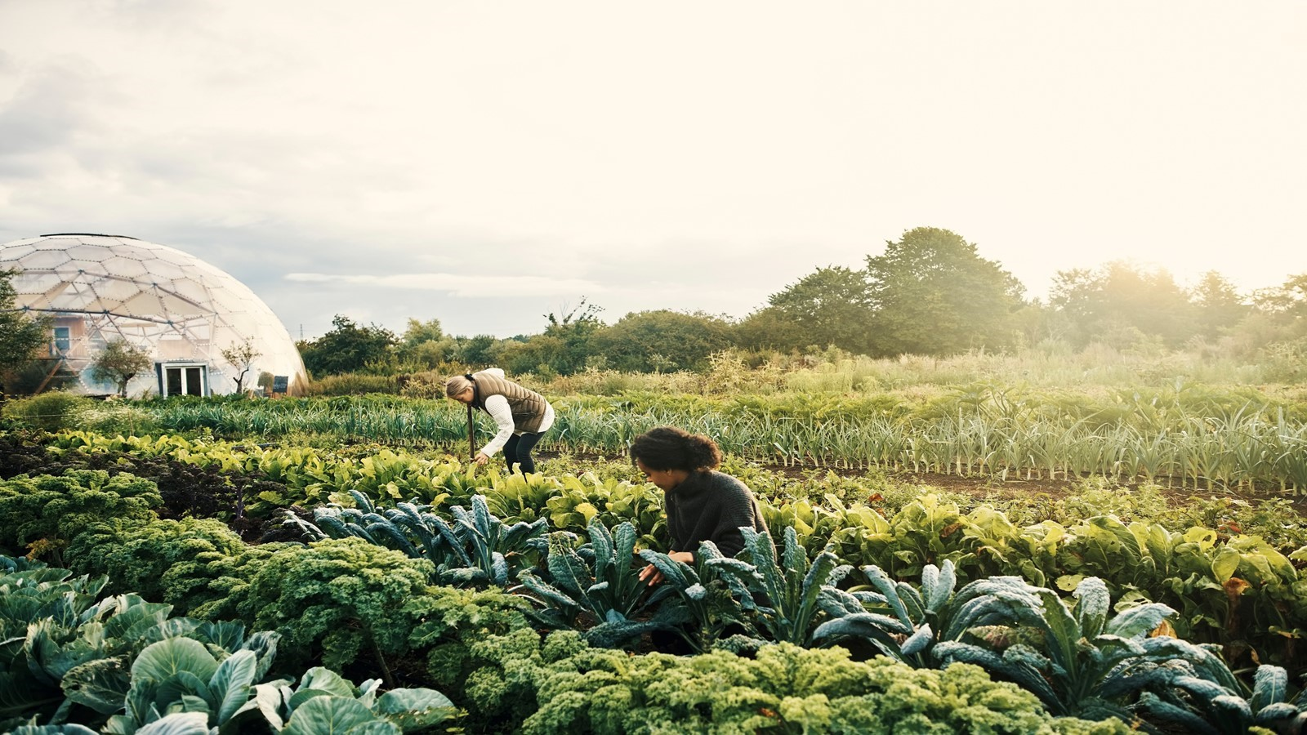
December Panel Discussion
Expert panel: Smither-Kopperl, Lazcano, York, and Rath
Discussion focused on structures supporting agricultural systems including soil health (emphasizing soil biota and biodiversity)
Dr. Rath of NRDC – Regenerative also about farmer well-being, community relations, human health, and innovation
Dr. York – must analyze site specific variables and challenges with testing and variability
Notes:
Starting with the December 13 discussion, which was Agenda item 6.
As you recall, you heard from a panel consisting of subject matter experts Dr. Margaret Smither-Kopperl from the Lockeford Plant Materials Center USDA Resources Conservation Service, Dr. Cristina Lazcano, associate professor from Soil Biodiversity and Health Lab, UC Davis, Timothy York, CEO of the California Leafy Green Marketing Agreement, and Dr. Daniel Rath, agricultural soil carbon scientist from the Natural Resources Defense Council (NRDC).
The panel, particularly Dr. Lazcano and Dr. Smither-Kopperl, provided information and context for a variety of factors that warrant consideration while defining “regenerative agriculture,” such as an emphasis on soil and soil health, as well as a question of what emphasis to put on biodiversity in soil, considering that research as to the importance of soil biodiversity is still being done and there are a lot of unknowns.
Dr. Rath of NRDC also stated that soil health and biodiversity were core principles, but also cited cultural practices, farmer well-being, community relations, human health, and farmer innovation as elements of regenerative agriculture.
Dr. Smither-Kopperl emphasized the need to measurement and monitoring, quickly changing environments, and variable effectiveness of particular practices in different environments, points that were underscored by Dr. York.

Slide 4
December Discussion Cont’d
Need to ask what the desired goals and outcome are – recreate pre-existing condition, or perhaps enhanced condition?
Interest in guarding against greenwashing
Definition would need to accommodate site-specific contexts
Questions about whether particular practices such as herbicide use or tillage would be permittable in a “regenerative system”
Questions about data sharing and how credit would be given to farmers using particular practices
Interest in guarding against greenwashing
Notes:
Some key points emerged from the following Science Advisory Panel discussion included:
That we need to ask what the desired goals and outcomes are
That we need to guard against greenwashing
That a definition would need to accommodate site-specific contexts, which as we know in California are incredibly variable with more than 400 crops and 2,000 soil types; even the types of tests done may not be the same and the way labs analyze them may not be the same.
Questions about whether particular practices such as herbicide use or tillage would be permittable in a “regenerative system,” and about whether more research was needed and how data would be shared or not shared given many farmers concerns about anonymity and privacy.

Slide 5
Literature Review
Overview ‘Regenerative Agriculture –the soil is the base’
(RA) is a solution towards sustainable food systems
A definition that allows for variability in location, cropping or livestock system, environment and farmer innovation
Need for indicators to assess performance
28 articles, narrowed down from 279, attempted to define Regenerative Agriculture:
Addressed various issues (soil health, climate change) and scales
Definitions based on activities and objectives
Activities: Operations/Implementation (Ex: farming practices)
Objectives: Capture a desire to reach a certain goal
Notes:
Dana

Slide 6
Literature Review cont’d
‘Regenerative Agriculture – The soil is the base’ Convergent Themes:
Enhance and improve soil health (n=61%)
Improve soil biodiversity (n=61%), Improve soil carbon (n=46%), soil physical quality (n=39%)
“a healthy soil is the basis for RA and therefore degraded agricultural soils should be restored to healthy soils” Rhodes (2012, P.380)
Optimize resource management (n=46%)
Reducing waste and optimal nutrient availability
Alleviate climate change / Improve water quality (n=29%)
Reduce GHG emissions, improve water quality and availability
Activities: Minimize external inputs, improving crop rotations, minimize tillage, using compost
These activities direct towards a food system that builds on its ecological cycles and as a co-benefit reduces environmental externalities (L. Schreefel, et.al, 2020)
Notes:
Dana

Slide 7
Literature Review cont’d
‘Regenerative Agriculture – The soil is the base’ Divergent Themes:
Regenerate the System
Vague description and did not define objectives
‘Restore earth’ and ‘Regenerate the natural system’
Improve human health
Relating to providing goods for human health to ensure global food security – showed high variability
‘We can express that (RA) aims for sustainable food production
Improve economic prosperity
Referring to economic sustainability of farmers but lacked operations
‘improves crop yields,’ ‘long-term economic sustainability,’ and political-economic repositioning’
Notes:
Dana

Slide 8
Literature Review Conclusion
‘Regenerative Agriculture – The soil is the base’ Conclusion:
“Regenerative Agriculture” focuses on themes such as enhance and improve soil health, optimize resource management, alleviate climate change, improve nutrient cycling and water quality and availability
Notes:
Dana

Slide 9
Draft Framework for Discussion
Positive impacts on environmental, social, and economic goals, including climate goals
Measurable and verifiable outcomes (keeping in mind variability throughout the state – but should also be outcomes farmers and ranchers can easily measure/not economically burdensome to measure)
Context-specific (scale, geographic location, agriculture system, goals, etc.)
Soil health (including elements of physical quality, carbon sequestered, and soil biodiversity, resource management, and alleviation of climate change)
Notes:
Virginia
I’d now like to turn to the draft framework. Extrapolating from panel discussion and the literature review, here are the elements that we are presenting as a draft framework.
First of all, it seemed clear from the discussion that the intention of “regenerative agriculture,” is to be positively additive when it comes to environmental, social, and economic goals, and that there’s often an emphasis on climate goals.
Next, to avoid greenwashing, there seemed to be consensus that progress made under regenerative practices should be measurable and verifiable. There seemed also to be an emphasis on making sure that the measurement techniques need to be accessible to farmers and ranchers.
It also seems like a definition would need to account for variability across agricultural systems, geography, scale etc.
And finally, the strong throughline for both the panel discussion and the literature was soil health, including elements of physical quality, carbon content, and biodiversity, with a focus on alleviation of climate change.

Slide 10
Next Steps
Need for March meeting?
Definition framework is provided to State Board of Food and Agriculture
Notes:
I’d now like to turn to the draft framework. Extrapolating from panel discussion and the literature review, here are the elements that we are presenting as a draft framework.
First of all, it seemed clear from the discussion that the intention of “regenerative agriculture,” is to be positively additive when it comes to environmental, social, and economic goals, and that there’s often an emphasis on climate goals.
Next, to avoid greenwashing, there seemed to be consensus that progress made under regenerative practices should be measurable and verifiable. There seemed also to be an emphasis on making sure that the measurement techniques need to be accessible to farmers and ranchers.
It also seems like a definition would need to account for variability across agricultural systems, geography, scale etc.
And finally, the strong throughline for both the panel discussion and the literature was soil health, including elements of physical quality, carbon content, and biodiversity, with a focus on alleviation of climate change.

