Slide 1
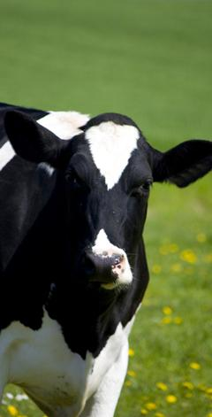
California Dairy Future Task Force
DRAFT Discussion Document
February 6, 2013
CONFIDENTIAL AND PROPRIETARY
Any use of this material without specific permission of McKinsey & Company is strictly prohibited
Notes:
ABSTRACT
This document offers insights into the company profile of ABB. First, the authors provide an overview of the company’s background and its five divisions: power products, power systems, discrete automation and motion, low-voltage products, and process automation. Then, they discuss ABB’s financial and stock market performance, highlighting the fact that the company has managed to steadily increase its revenues and improve margins, which proved to be a stable double-digit (even during the economic crisis). Next, the authors discuss the news and recent developments of ABB. Finally, they present the management profiles of the company’s key executives. Key slides include 1 (summary), 3 (company background), 5 (overview of five divisions), 14 (revenues trend), and 19-20 (news and recent developments).

Slide 2
Objectives for today’s meeting
Agree on roles going forward
Clarify objectives for each strategic pillar
Plan communication with the industry

Slide 3
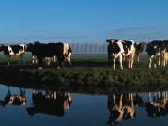
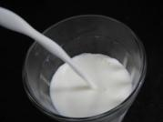
At our last meeting we accomplished 3 of our 4 objectives
1
Establish a shared fact base
Look at CA Dairy’s successful 100-year journey
Understand CA’s recent challenging history
Review current market, pricing and regulatory environment
2
Draft a vision for the long term future of CA Dairy
Define elements of vision statement
Draft statement into single, cohesive statement
3
Select a set of strategic pillars to support vision
21st century pricing system
Comprehensive export and domestic growth plan
Building the right business model for producers
4
Discuss and review potential solutions for short term action
Discussion on how to prevent producer bankruptcies over next 0-12 months
Several proposals put forth
Task force sub-group proposal not adopted by overall group
2

Slide 4
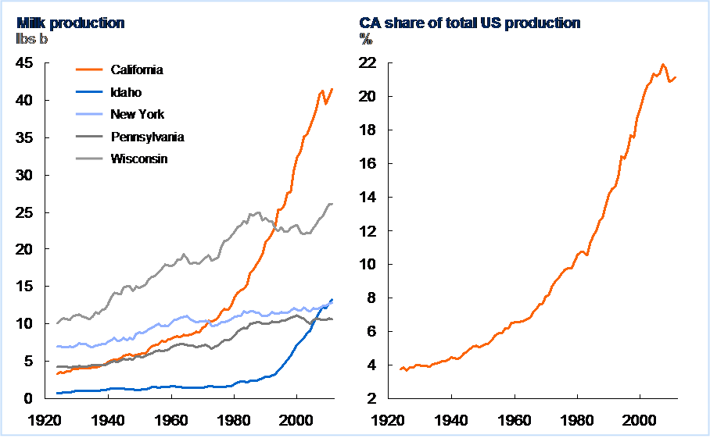
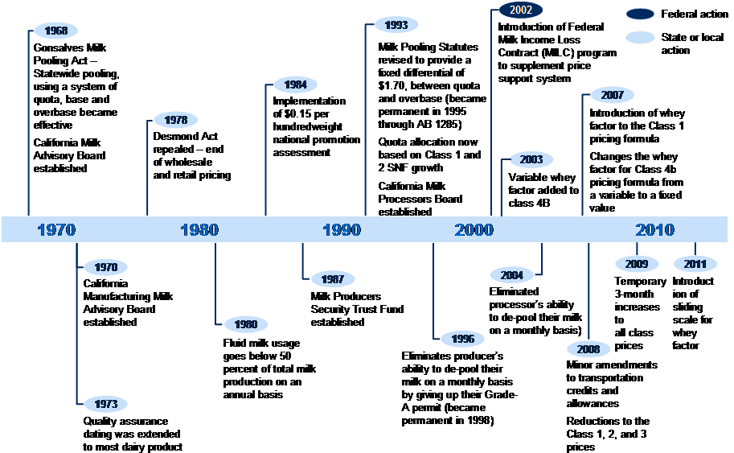
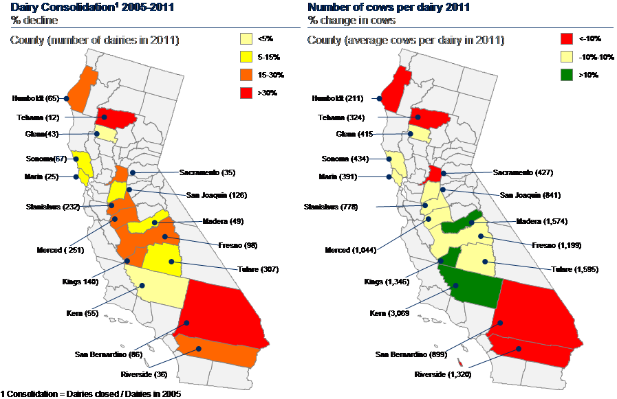
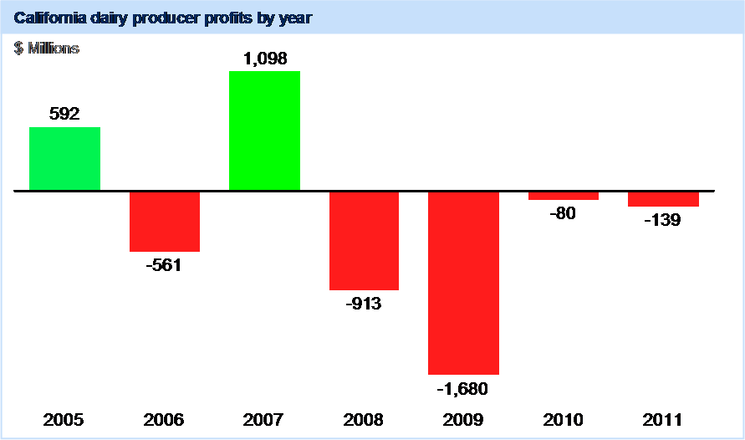
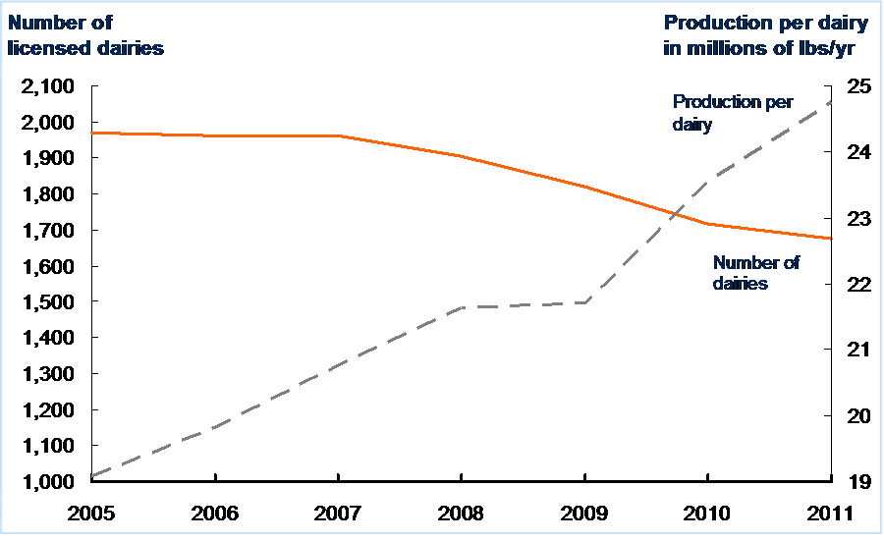
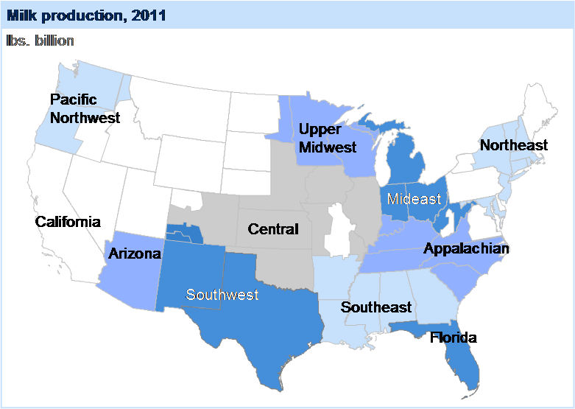
Establish a shared fact base
1
✓
100-year
successful history
Key dates
Size of dairies
across CA
Producer profits
Dairy consolidation
Production across
the country
3

Slide 5
Draft vision statement for the future of the CA Dairy Industry
2
✓
California dairy economically sustains producers and processors through profits and growth. We grow demand for milk including high value products. We use a coordinated approach to ensure significant, continued investment in processing and product. We are the leading global dairy exporter.
4

Slide 6
Strategic pillars to support the vision statement
3
✓
A
21st century pricing system
E
Coordinated industry regulatory strategy
Growing the right processing capacity for CA
B
F
Comprehensive domestic growth plan
C
Comprehensive export growth plan
Building the right business model for producers
G
D
Product differentiation and innovation plan
5

Slide 7
The journey from here
We are worried the industry is on the wrong track…
…are becoming less optimistic as time goes on…
More optimistinc
Right track
13%
Same
36%
40%
64%
47%
Wrong track
Less optimistic
…and believe this task force can take the industry forward with the right approach
“We need to consider all options from regs, pricing, markets and not just look to tweak what we have”
“Have a
reality check”
“Open minds”
“More education and focus on building understanding of these issue”
“Put forward the recommendations that keep all plants and producers together for the benefit of the industry”
“Reduce the polarization of the entitlement thinking”
SOURCE: California Dairy Future Task Force Survey Feb. 2013, N=22

Slide 8
The Task Force sees its most important roles as making recommendations, generating ideas and communicating to the industry
Blended important score based on ranking in survey
Making recommendations for change
3.64
Generating ideas and solutions for the future
3.32
Communicating ideas to the industry
3.23
Analyzing strategic options
3.14
Conducting research on strategic options
2.91
Gathering feedback from the industry
2.91
SOURCE: California Dairy Future Task Force Survey Feb. 2013, N=22

Slide 9
Update since our last meeting
The Task Force remains a critical forum to set direction, generate ideas and get feedback and communicate with the industry
Secretary Ross asked a group of industry leaders to come together as a Steering Group after our last meeting to keep the discussion moving forward by providing leadership and a link to organizations instead of just individuals
The Steering Group reviewed the draft vision and strategic pillars the Task Force created in October and suggested a set of Working Groups to explore the technical details and options related to each topic
The Dairy Advisory Committee has been discussing how to fund this work and ensure accountability

Slide 10
Proposed roles going forward
Description
Role
Task Force
Larger group of active industry individuals from across the spectrum with direct personal stake in the industry
Set high level direction
Generate ideas
Give input and feedback on proposed solutions
Ambassadors- provide two way communication with the industry
Steering Group
Smaller group of industry leaders focused on California with formal roles/connection to
Translate high level direction from Task Force into specific action and keep the effort moving
Integrate Working Group research and analysis
Bring forward holistic solutions, strategic direction
Working Groups
Technical experts with knowledge and experience in the detailed questions facing the CA Diary industry
Conduct research and analysis on detailed questions related to each strategic pillar
Identify options, benefits, risks, impact and actions required
Dairy Advisory Committee
Existing Dairy Advisory Committee
Provide oversight and accountability for public funds used to support this effort
Provide input and feedback
CDFA
CDFA staff, resources and data
Support this effort and provide information, analysis convening and coordination as the industry addresses long term vision for CA Dairy

Slide 11
How these groups can work together to move the California Dairy industry toward our long term vision
Industry
Sharing information
Seeking input
High level direction
Feedback
Task Force
Integrated options
Holistic solutions
Steering Group
Options
Scenarios
Pros/Cons
Working Group 1
Working Group 2
Working Group 3
Working Group 4
Dairy Advisory Committee
CDFA

Slide 12
Proposed approach for the initial working groups
The Steering Group has proposed setting up four initial working groups
The Working Groups will explore specific topics to provide more detail on:
“21st Century Pricing”
“Growing the Right Processing Capacity for California”
For each topic the working groups will be working to identify:
How would different options help us achieve our goals and vision?
What are the benefits and risks?
What would be required to make change happen?
How would this impact the structure of the industry?
How can we move beyond the historical precedent and do something new?

Slide 13
Proposed topics for the initial working groups – Reforming Class 4 Pricing
California’s regulated pricing system has failed to keep pace with the rapidly changing global marketplace. Instead of adapting to the changing marketplace and incenting industry participants to grow the value of milk, this regulated approach to pricing has turned our focus away from the marketplace and led to many unproductive and contentious debates around value sharing.
This group will to explore alternative market based solutions to pricing 4a and 4b milk in California. The goal of this working group is to evaluate market based pricing models and develop a pricing mechanism that appropriately shares risk between producer/processor, promotes competition, incents innovation, and direct milks to the highest and best use.

Slide 14
Proposed topics for the initial working groups – Quota System
If the California pricing system were to be changed to deregulate Class 4 (representing today about 75% of the pool), and assuming pool utilization for Classes 1, 2, and 3 were not to change, financial support from the remaining pool for quota payment would drop to about 25% of where it is today.
This result would create a very difficult environment for quota to survive in the California milk pricing system.
So, what could be done with quota? How might quota be retired? Would it be allowed to simply go away with no compensation to quota holders or should its retirement be financed? How might tax consequences that would result to quota holders as a result of quota retirement be addressed?

Slide 15
Proposed topics for the initial working groups – Risk Management
If alternatives to current regulated pricing programs are to be considered, knowledge of how producers can be equipped to participate successfully in a different business environment is essential. Understanding of comprehensive risk management must be a key component of any alternative proposal. Risk management tools have been seen as complicated and costly trading programs requiring considerable expertise and carrying large downsides for producers aiming to manage their milk price. Also, understanding of risk management has not broadened to include study of existing statutory and regulatory safeguards against negative business practices, such as handler bonding requirements and contract enforcement, unlawful practices prohibitions, maintenance and use of the Producer Security Trust Fund, among others.
This working group will gather information on the range of risk management approaches that can be adapted to provide producers with a variety of useable choices to control their exposure to changes in market conditions, changes in input costs, and changes in milk price.

Slide 16
Proposed topics for the initial working groups – Increasing industry assets
Global demand for dairy will continue to rise creating a significant business opportunity. Demand will result from the projected world-wide population growth and in the increase in the size of the middle class with more disposable income. California is currently under developed to capture this opportunity and requires an increase in the processing capacity within the State.
The dairy industry in California is uniquely positioned to meet global demand. Our business model delivers a safe, secure, and scalable milk supply, is geographically well positioned, and has access to a strong infrastructure to deliver these products to market. Our asset base has not kept pace with the market place requirements creating an imbalance in supply and resulted in a loss of revenue.
Our objective is a healthy growing dairy industry that is economically sustainable across the supply chain from producer, to processor and ultimately through to the consumer. The output from this work group will be to deliver a set of industry recommendations that will assist in the retention of current business, expansion of current assets, and attract new processing to the State of California.

Slide 17
Continuing our work on the strategic pillars
Choose the pillar that you want to focus on and go to that station
Review the work from October on that pillar
In your group discuss the following questions
What are the specific goals for this strategic pillar and how do those fit with the working group topics?
How would we know if we’ve achieved those goals?
What actions must be part of this pillar to transform the industry and make that change sustainable for the long term?
What are risks we need to manage related to this pillar?
What specific questions should the working groups answer for the next Task Force?
Select someone to report back to the group

Slide 18
Strategic pillar breakout questions
TEMPLATE
Topics
Break out discussion
Specific goals
…
…
…
How we’ll know
…
…
…
Actions required
…
…
…
Risks to manage
…
…
…
Questions for the working groups
…
…
…

Slide 19
Change will not be easy and will require communication with the industry
Strong Leadership
A Compelling
‘Change Story’
“…I see a clear set of leaders all behaving differently and saying/ doing the same thing.”
“... I understand what is being asked of me and why it makes sense.”
“…I have the information and opportunities to work together effectively with others.”
“…I see the structures, processes, and systems support the changes I am being asked to make.”
Teamwork and
Coordination
Formal Systems
SOURCE: McKinsey Organization and Change Management Practice

Slide 20
Change requires significant communication with the industry through multiple channels
What is the purpose of our communication with the industry?
Which channels and methods best fit our purpose and message?
Sharing information
Ensure consistency and accuracy of information
Keeping people informed about the process
Letting people know the options that are being discussed
Getting input and feedback
Collection reaction to different ideas
Identifying faulty assumptions
Testing possible changes for support
Building support for change
Educating people about the facts
Getting people excited about options
Identifying supporters and getting them engaged
Refining messages
General industry communication channels
CDFA communications and events
Industry newsletters
Media communication channels
Agriculture reporters
Dairy reports
Regional reports
Specific communication channels
Website
Social media (Facebook, Twitter)
Town Hall meetings
Board presentations (e.g. CMAB)
Open Task Force meetings
What is the purpose and method s of communicating with the industry?

Slide 21
The facts you find most compelling from our discussions so far
Percent describing as “very important”
CA consistently earns less revenue per cwt than its peer states
85%
Producers have faced a challenging economic climate in recent years
70%
CA’s lower revenues have outweighed the
state’s cost advantage and led to negative margins
70%
CA cost volatility and increases have
been primarily due to increases in feed costs
45%
Both producers and processors face regulatory challenges in CA
45%
CA processing capacity has not grown significantly
40%
The CA minimum regulated price is calculated based on classes price
and pool percentages – each class price is based off complex formulas
35%
CA has retained a competitive cost of production
compared to other dairying states
30%
SOURCE: California Dairy Future Task Force Survey Feb. 2013, N=22

Slide 22
Key messages and our role in communication
In pairs with the person next to you discuss the following questions:
What are the key messages we should share with the industry?
What have you learned so far that would be surprising to some of your peers?
What are the multi-channels to get those messages out?
What will you do personally to share those messages?

Slide 23
Proposed agenda for next Task Force meeting
Report back on long term perspective from industry
Briefing on pricing approaches around the world
Review initial “deep dives” by working groups
Agree on decision making approach and governance
…
…

Slide 24
Draft process for 2013 and beyond
Phase 1: Building a path forward
Phase 2: Assessing viable options
Phase 3: Building and launching the action plan
Phase 4: Executing the action plan
1 month (Jan-Feb)
3 months (~Feb-May)
3 months (~May-Aug)
Ongoing
Agree upon governance and decision making process for long term action plan,
Set up process to develop long-term action plan (e.g., how work will get done)
Identify and collect data needed for technical teams
Technical teams do detailed analysis (e.g. options, scenarios, pros/cons) for 4 priority strategic pillars to build an action plan:
21st century pricing approach
Growing processing capacity
Comprehensive export growth plan
Product differentiation and innovation
Bring options for strategic pillars to Task Force and Advisory Committee for input (e.g., potential pricing approach options)
Share options across industry in small group workshops
Select key initiatives from the options and integrate into an action plan
Launch key initiatives in plan with working teams
Set up “project-management office” (e.g., permanent Task Force) to oversee and implement action plan
Ongoing industry workshops to share
Different sets of stakeholders take action on specific initiatives which could include:
Internal industry projects, reform and education
Assignment of funds and responsibility for new activities to existing groups
Requests for regulatory or legislative action

Slide 25
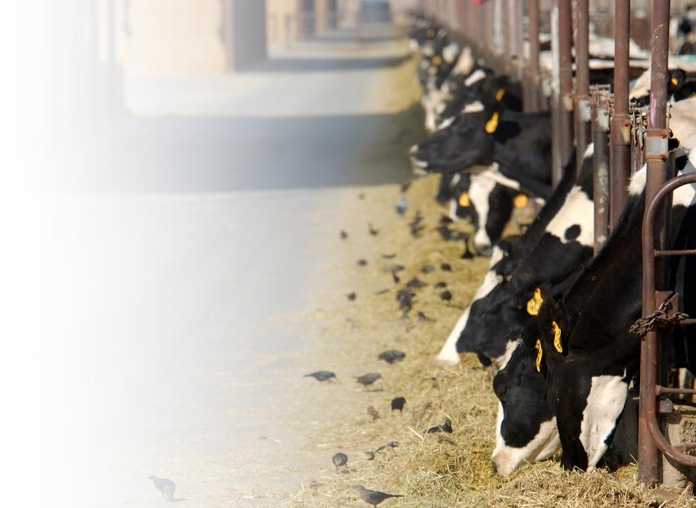
Next steps
Working groups to kick-off and start research and analysis
Finalize process and support plan for this work
Task Force members communicate with the industry
Next Task Force meeting in ~2 months to review progress
24

Slide 26
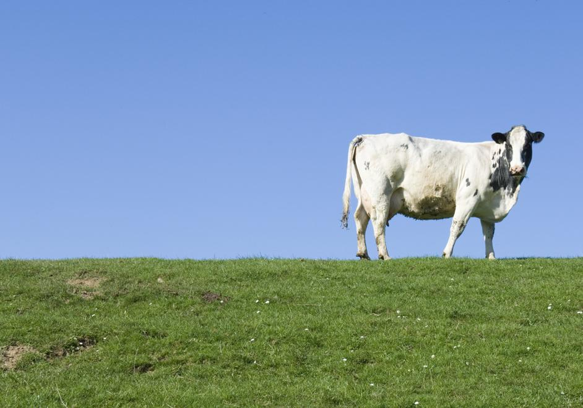
THANK YOU

Slide 27
Appendix
SOURCE: Source

Slide 28
21st century pricing system
OCTOBER REPORT
Key elements
Takeaways
Important components
Use market driven signals to capture full value of product
Flexible and competitive
Real time pricing (i.e., eliminate lags)
Less regulated process overall
Use tiered pricing – small processors and enterprise zones
Potential leaders
Create sub-group to develop a plan; consider:
Task force members
Dairy economists
Other industry leaders
Consider using a facilitator or experts to support
Next steps to make progress
Put together draft plan in 6 months and try to implement
Revisit and fine tune over a 12 month period

Slide 29
Growing the right processing capacity for California
OCTOBER REPORT
Key elements
Takeaways
Important components
Create price stability, contracting options, regulatory stability, supply stability and use WI model of streamlined regulation
Create enterprise zones
Focus on what the market wants
Develop favorable financing and business climate
Potential leaders
Development coalition
CMAB
Next steps to make progress
ASAP and ongoing

Slide 30
Product differentiation and innovation plan
OCTOBER REPORT
Key elements
Takeaways
Important components
Innovation in use, packaging, marketing etc with an emphasis on higher value products
Create shared funding and public-private partnerships
Be flexible to new funding models (e.g., check off funds)
Conduct marketing and research efforts – adjust as necessary
Potential leaders
National Dairy Board
CMAB
Steve Maddox
Others active in the marketplace
Processor representative – someone from research
Next steps to make progress
Create specific working group
Define a clear objective
Formalize the right way to measure progress (e.g., measurement matrix)w

Slide 31
Comprehensive export growth plan
OCTOBER REPORT
Key elements
Takeaways
Important components
Industry group to support export development through trade missions and market access discussions
Work with Universities to support product development especially for international markets and compliance
Align milk pricing system to support export growth
Vertical collaboration in the industry
Focus on differentiating CA products in the market (e.g., quality, high environmental standards)
Potential leaders
CMAB
Dairy Export Council
Export experts in processor’s companies
Next steps to make progress
Create working group
Set clear objective and overall timeline
Kick-start process

Slide 32
Coordinated industry regulatory strategy
OCTOBER REPORT
Key elements
Takeaways
Important components
Streamline regulatory process for producers and processors
Focus on reducing redundancies (e.g., clearing house)
Consider economic impact of regulations
Increase education of effective compliance among producers and impact among legislators
Potential leaders
Processor and producer trade associations (e.g, WUD, Dairy Institute)
Dairy co-ops (e.g., CDI, LOL, DFA)
Next steps to make progress
Create working group
Set clear objective and overall timeline
Kick-start process

Slide 33
Comprehensive domestic growth plan
OCTOBER REPORT
Key elements
Takeaways
Important components
Product innovation and R&D with a focus on convenience
Review product standards of identification
Opportunity for more inclusion and blends
Create a more business friendly climate (e.g., regulations and tax incentives)
Focus on what the world wants – product, package etc
Industry partnerships (e.g., producer, processor) and partnerships with global companies
Potential leaders
CMAB
Leading national co-operatives (e.g., CDI, LOL)
Next steps to make progress
Align on proper leader(s) for California domestic growth plan
Set overall objective for group (e.g., domestic growth target) and timeline to get there

