Slide 1
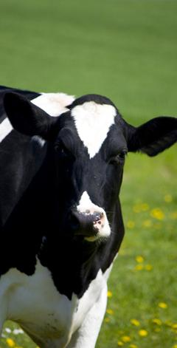
Update on the California Dairy Future Task Force and moving forward
CMAB Board Presentation
December 5, 2012
CONFIDENTIAL AND PROPRIETARY
Any use of this material without specific permission of McKinsey & Company is strictly prohibited
Notes:
ABSTRACT
This document offers insights into the company profile of ABB. First, the authors provide an overview of the company’s background and its five divisions: power products, power systems, discrete automation and motion, low-voltage products, and process automation. Then, they discuss ABB’s financial and stock market performance, highlighting the fact that the company has managed to steadily increase its revenues and improve margins, which proved to be a stable double-digit (even during the economic crisis). Next, the authors discuss the news and recent developments of ABB. Finally, they present the management profiles of the company’s key executives. Key slides include 1 (summary), 3 (company background), 5 (overview of five divisions), 14 (revenues trend), and 19-20 (news and recent developments).

Slide 2
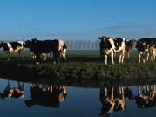
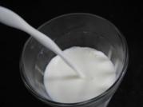
The CA Dairy Future Task Force meeting accomplished 3 of its 4 objectives
1
Establish a shared fact base
Look at CA Dairy’s successful 100-year journey
Understand CA’s recent challenging history
Review current market, pricing and regulatory environment
2
Draft a vision for the long term future of CA Dairy
Define elements of vision statement
Draft statement into single, cohesive statement
3
Select a set of strategic pillars to support vision
21st century pricing system
Comprehensive export and domestic growth plan
Building the right business model for producers
4
Discuss and review potential solutions for short term action
Discussion on how to prevent producer bankruptcies over next 0-12 months
Several proposals put forth
Task force sub-group proposal not adopted by overall group
1

Slide 3
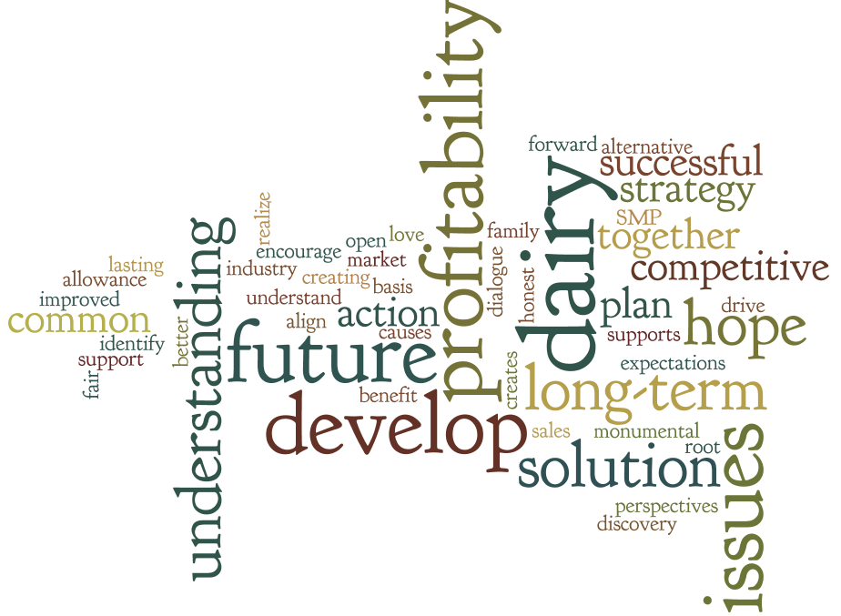
Task force participants aspirations and hopes for the task force
2

Slide 4
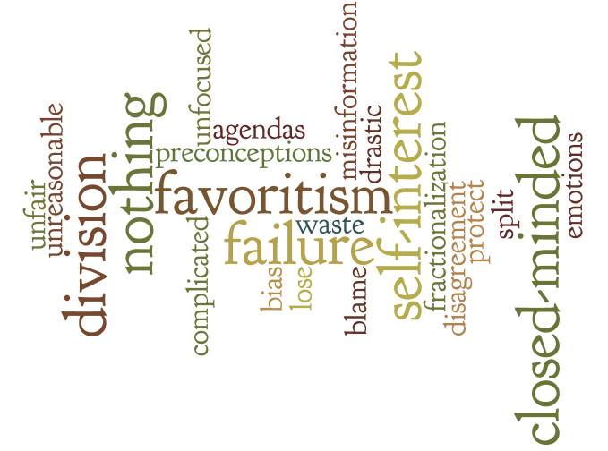
Task force participants fears and concerns for the task force
3

Slide 5
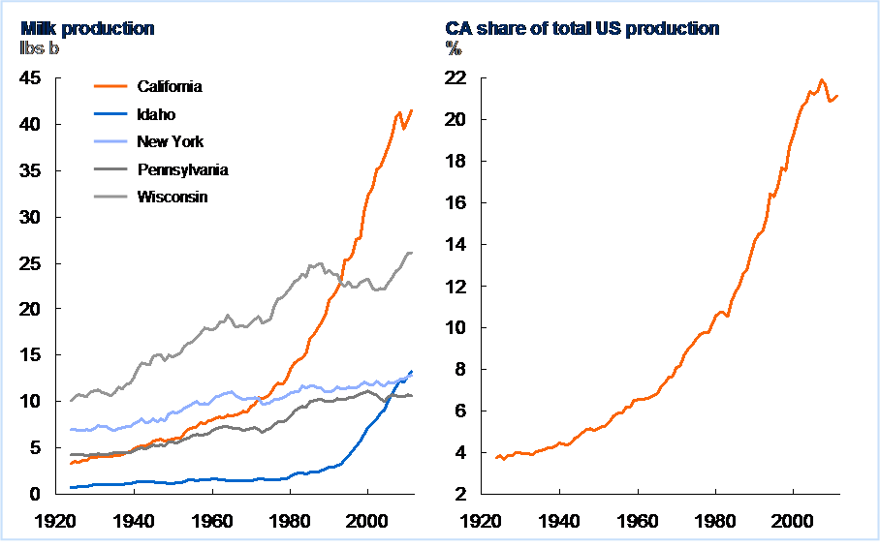
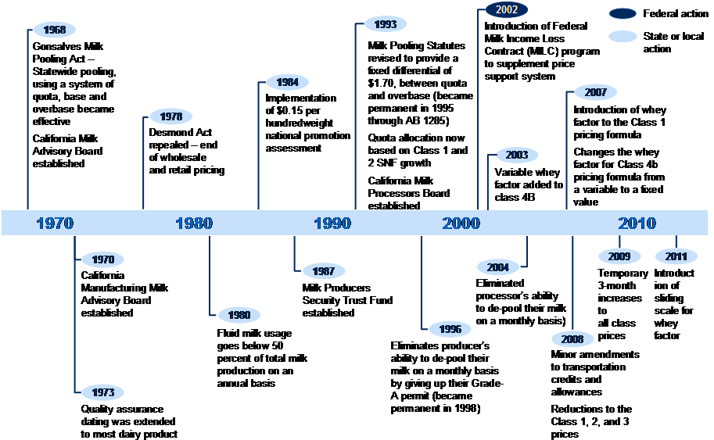
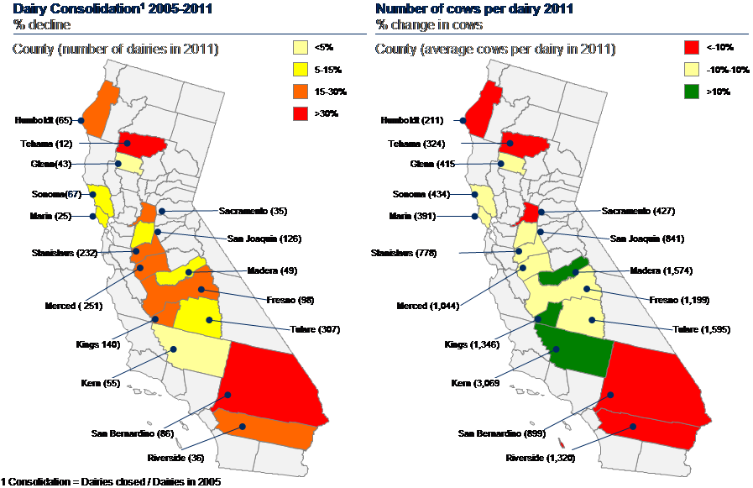
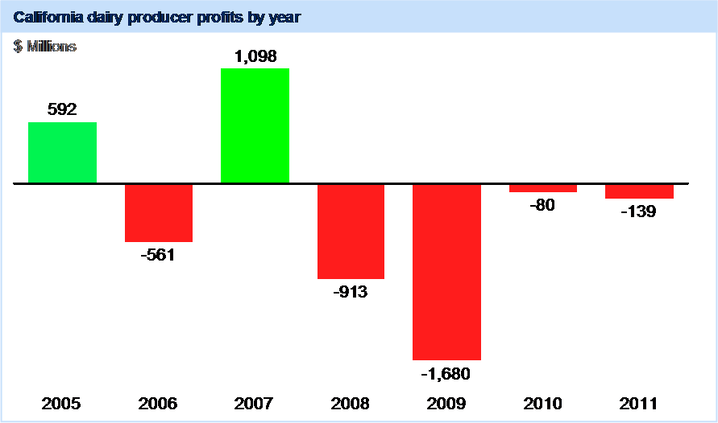
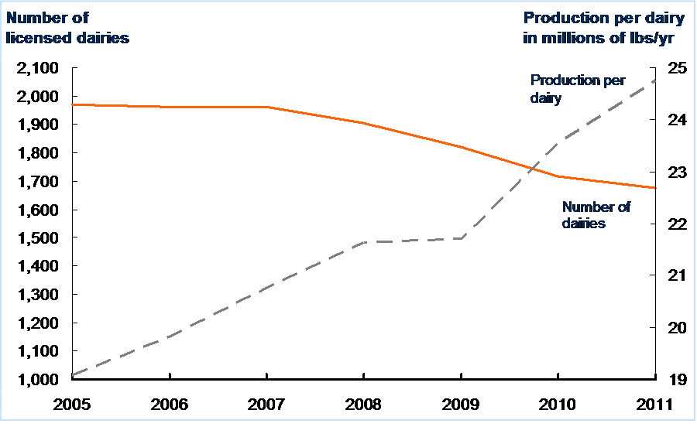
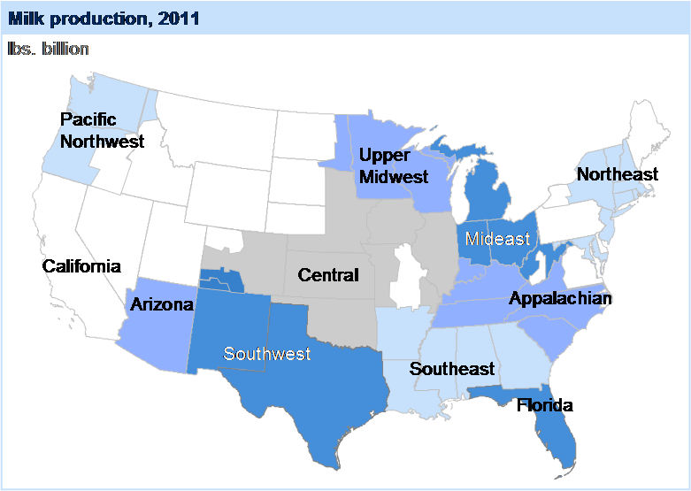
Establish a shared fact base
1
✓
100-year
successful history
Key dates
Size of dairies
across CA
Producer profits
Dairy consolidation
Production across
the country
4

Slide 6
Draft vision statement for the future of the CA Dairy Industry
2
✓
California dairy economically sustains producers and processors through profits and growth. We grow demand for milk including high value products. We use a coordinated approach to ensure significant, continued investment in processing and product. We are the leading global dairy exporter.
5

Slide 7
Strategic pillars to support the vision statement
3
✓
A
21st century pricing system
E
Coordinated industry regulatory strategy
Growing the right processing capacity for CA
B
F
Comprehensive domestic growth plan
C
Comprehensive export growth plan
Building the right business model for producers
G
D
Product differentiation and innovation plan
6

Slide 8
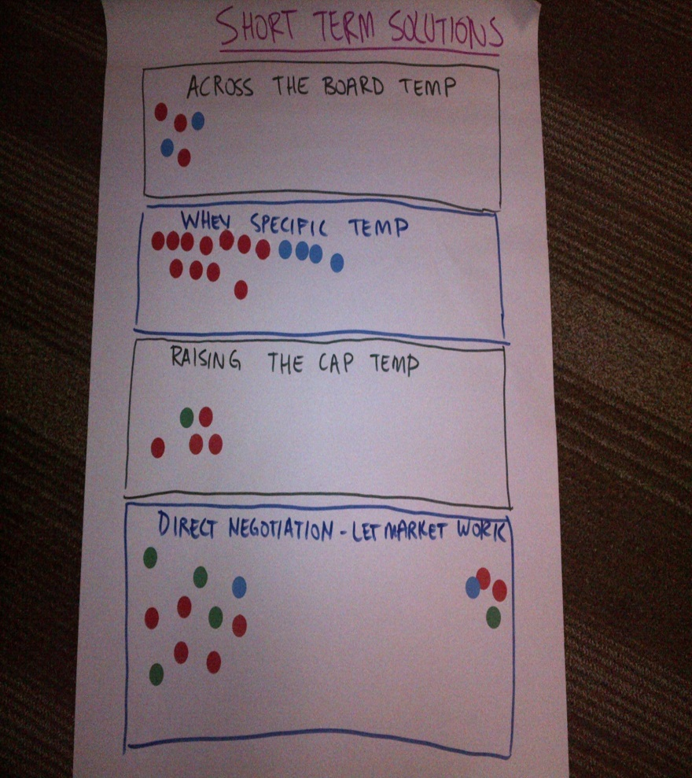
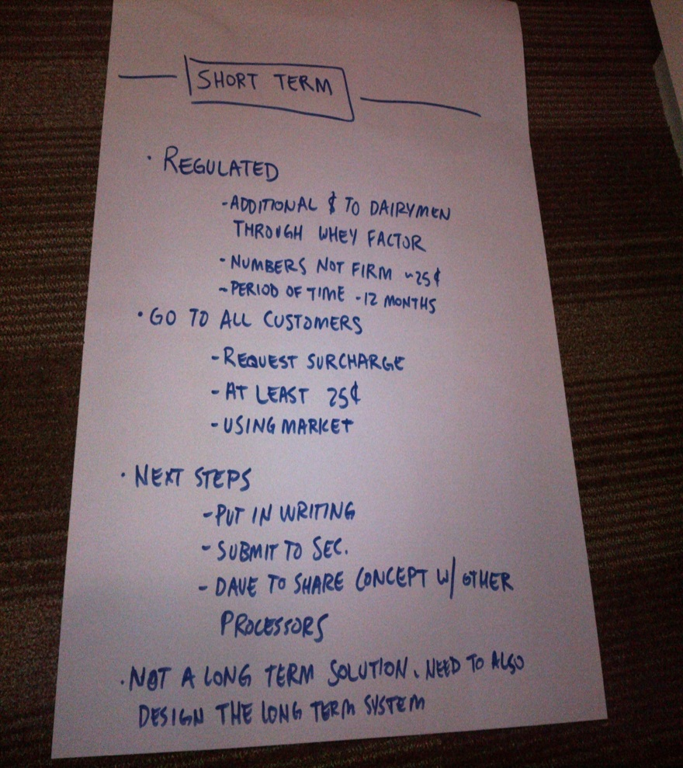
Discuss and review potential solutions for short-term action
û
4
Proposals and voting for short-term solutions
Task force sub-group proposal
7

Slide 9
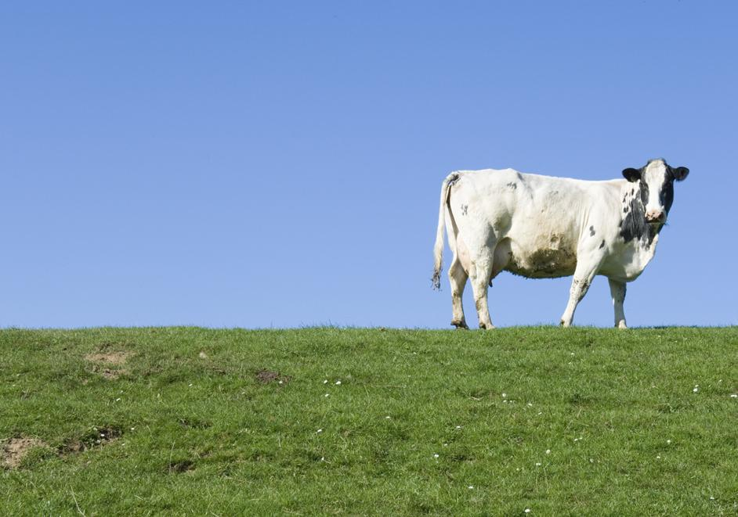
Next steps for the Task Force
Task Force wishes to continue to meet to push forward on the long-term vision and will convene on January 14-15th
Strong leadership and teamwork from all parts of the industry is needed to work on that vision

Slide 10
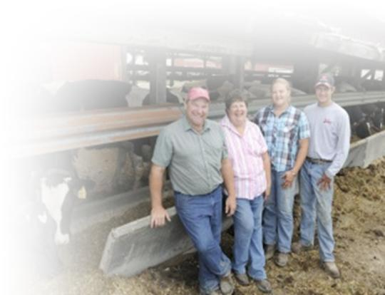
Change takes times – New Zealand dairy example
New Zealand example
Implications for CA diary
In 1994, industry faced growth and innovation challenges due to a lack of coordination
Cost model pooling system incented processors to “beat the model” rather than focus on innovation and producers to oversupply¹
Producers and processors go co-commissioned a report on how to drive efficiency improvement
Merged 15 co-ops into 4
Working team formed to capture “Business Development Project” opportunities
New pricing system to incent product differentiation and supply controls
Changes took several years to be agreed to and implemented
Change doesn’t happen in one day – accomplishing 3 out of 4 objectives in initial meeting represents progress
Continuing the dialogue across the industry is critical – it’s the only path to a long term solution
1 SOURCE: AREN, “Key elements of success and failure in the NZ dairy industry”, 2008 ; McKinsey analysis
Notes:
Feed prices from: Cost of Milk Production 2005-2011
Number of dairies from: Cost of Milk Production 2005-2011
Milk supply from:

Slide 11
Questions that still need addressing to realize the long-term vision
Dairy producers
Dairy processors
End markets
Should California dairymen join together as one co-op?
How can dairymen best work together to optimize overall production?
Can dairymen alter their pool mix?
Are milk pricing decisions a win/lose game for producers and processors, or are there win/win solutions?
What changes are needed to drive investment in capacity?
Will demand – foreign or otherwise – ever really impact profitability?
Are there ways to influence the price of products impacted by oversupply?
Industry wide
How should the pricing system be structured to support a healthy industry?
What innovations would help materially improve prices? How can dairymen encourage investment in such innovations?
How should dairymen work with the processors and the state government?
10

Slide 12
Again, change is not easy and will require leadership and working will all members of the industry
On track / underway
Some action but no clear plan
No action to date
Actions needed
Actions needed
Status
Status
Display leadership by promoting collaboration
Empower representatives in the Task Force to make decisions
Strong Leadership
Support the California Dairy Vision for Success
Define benefits of supporting pillars
A Compelling
‘Change Story’
“…I see a clear set of leaders all behaving differently and saying/ doing the same thing.”
“... I understand what is being asked of me and why it makes sense.”
Maintain Dairy Future Task Force as a forum for collaboration
“…I have the information and opportunities to work together effectively with others.”
21st century pricing system
Export Growth
Financing for innovation
Processing capacity
“…I see the structures, processes, and systems support the changes I am being asked to make.”
Teamwork and
Coordination
Formal Systems
SOURCE: McKinsey Organization and Change Management Practice

Slide 13
What a roadmap could look like
Phase 0 (2 months): alignment on moving forward to build an action plan
Phase 1 (3 - 4 months): developing an action plan to reach the Future Vision of CA Dairy
Phase 2 (2-3 months): implementing the action plan
2 months
3 - 4 months
2-3 months
December
January Dairy Future Task Force
Monthly Task Force meeting
Monthly Task Force meeting
Monthly Task Force meeting
Monthly Task Force meeting
Monthly Task Force meeting
Monthly Task Force meeting
Agree to work together to build long-term vision
Use Dairy Future Task Force as representative decision-making body
Set up process to develop long-term action plan (e.g., how work will get done)
Detailed analysis on options for 3-4 priority strategic pillars to build an action plan:
21st century pricing system
Growing processing capacity
Comprehensive export growth plan
Product differentiation and innovation
Bring options for strategic pillars to Task Force for decisions (e.g., potential pricing system options)
Share action plan across industry in small group workshops
Launch key initiatives in plan with working teams
Set up “project-management office” (e.g., permanent Task Force) to oversee and implement action plan

Slide 14
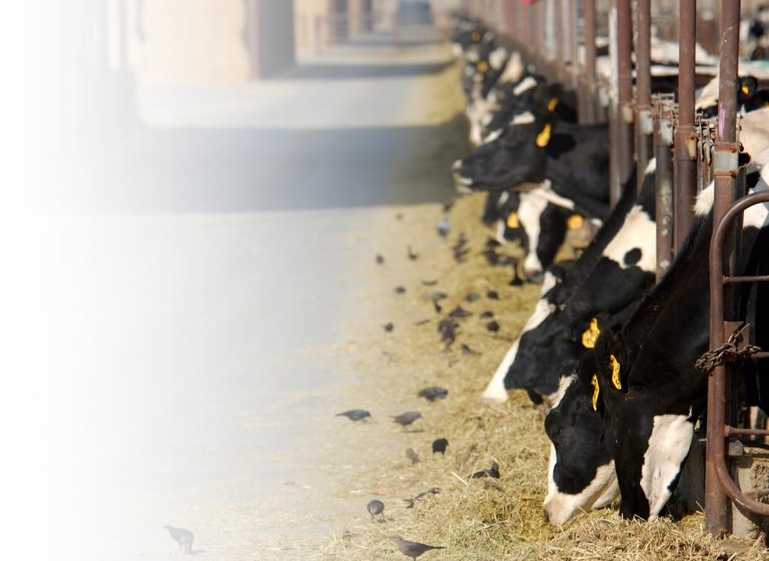
Next steps
Decide whether to take action against the long term vision for future
Should you want to push the vision forward, think through how best to collaborate with the state and with processors on doing so
Work to set up a team with a timeline and deliverables
13

Slide 15
THANK YOU

